Slide 1
Microsoft Azure The cloud platform for digital transformation
Kevin Harris
Azure GBB TSP for CAD
Microsoft

Slide 2
Engage your customers
Transform your products
Digital transformation
Empower your employees
Optimize your operations

Slide 3


GOING DIGITAL
1 million/hour
new devices coming online
by 2020
12 years
average age of S&P 500 corporations
by 2020
60% computing
in the public cloud by 2025

Slide 4
Application innovation
Accelerate innovation with the cloud
Data and intelligence
Power decisions & apps with insights
Microsoft Azure
Openness and flexibility
Build freely, deploy anywhere
Trust
Protect your business

Slide 5
Application innovation Accelerate innovation with the cloud
Build apps faster and easier
Manage applications proactively
Deliver native mobile apps seamlessly

Slide 6
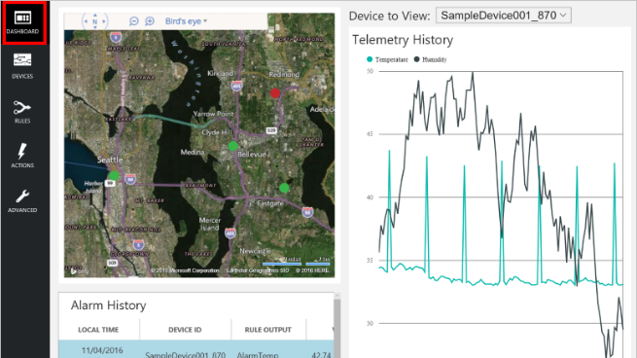
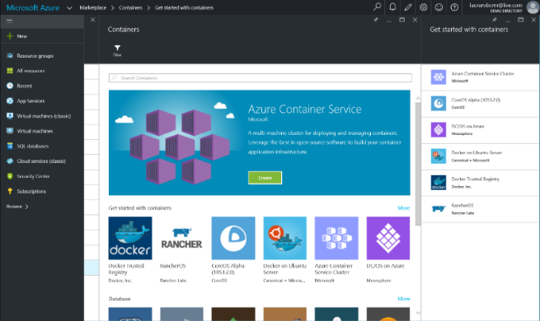
Build apps faster and easier
Build on PaaS
Azure
Internet of Things
Azure Marketplace
Existing frameworks
Web and mobile
Microservices
Serverless Compute
Build on IaaS
Virtual machines
Storage
Networking

Slide 7
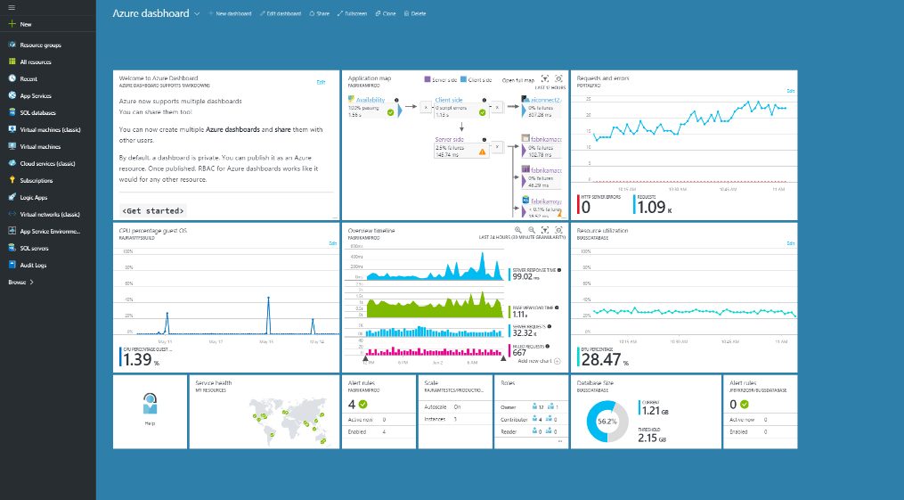

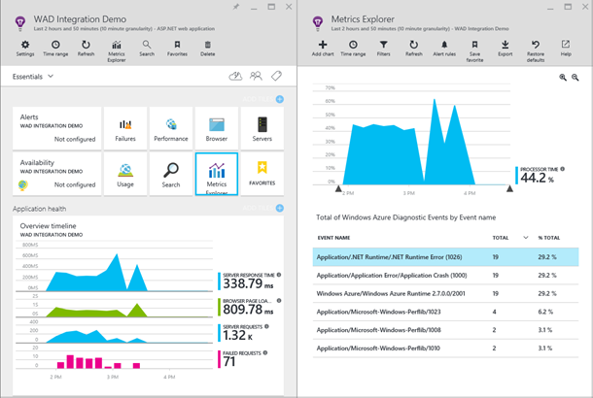
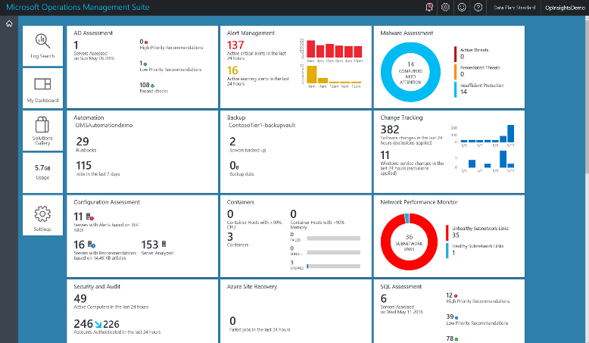
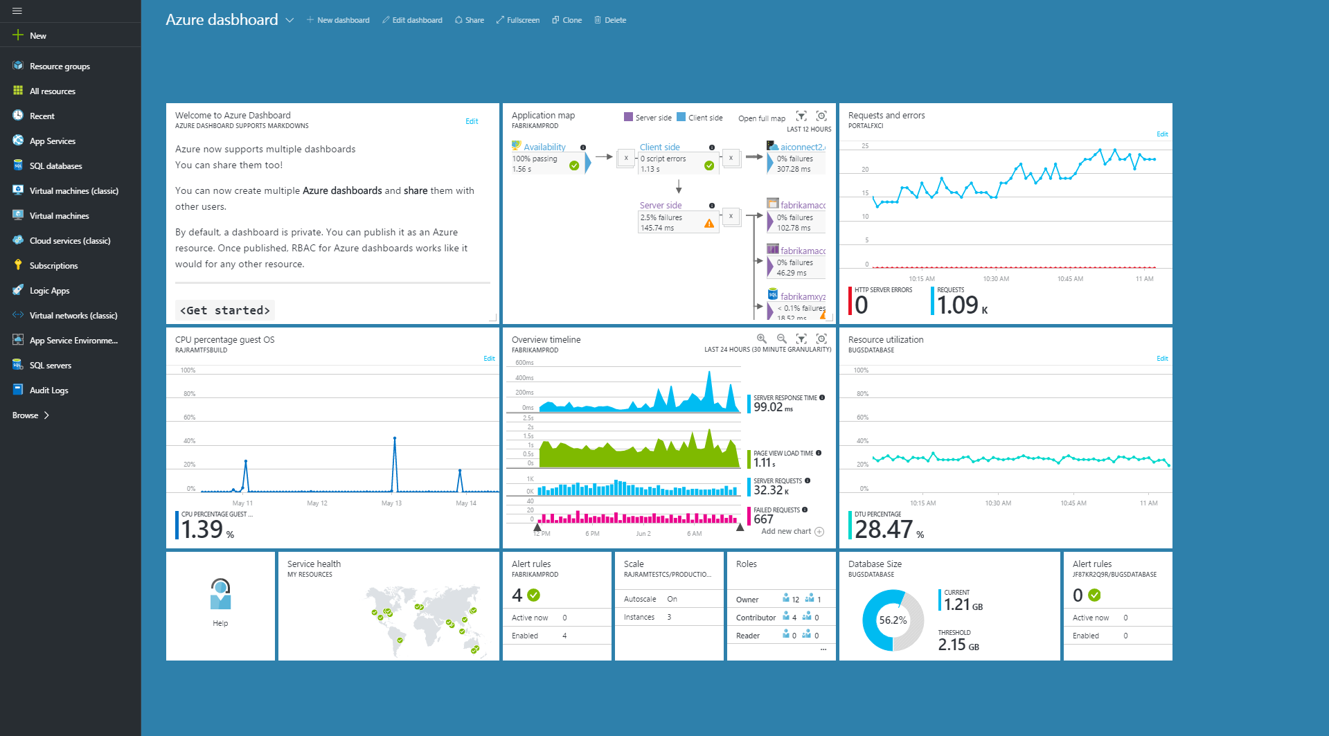
Manage applications proactively
Azure Portal
Application Insights
Operations Management Suite

Slide 8

Deliver native mobile apps seamlessly
Mobile DevOps
Mobile Back-end Services
Code Repository
Build + Deploy
Automated Testing
User Testing
Cloud and Offline Data
User Authentication
Backlog
Push Notifications
Monitor and improve

Slide 9

Application innovation

Slide 10
Application innovation
Accelerate innovation with the cloud
Data and intelligence
Power decisions & apps with insights
Microsoft Azure
Openness and flexibility
Build freely, deploy anywhere
Trust
Protect your business

Slide 11
Data and intelligence Power decisions & apps with insights
Support business strategy with any data
Predict and respond proactively
Learn and engage with artificial intelligence

Slide 12
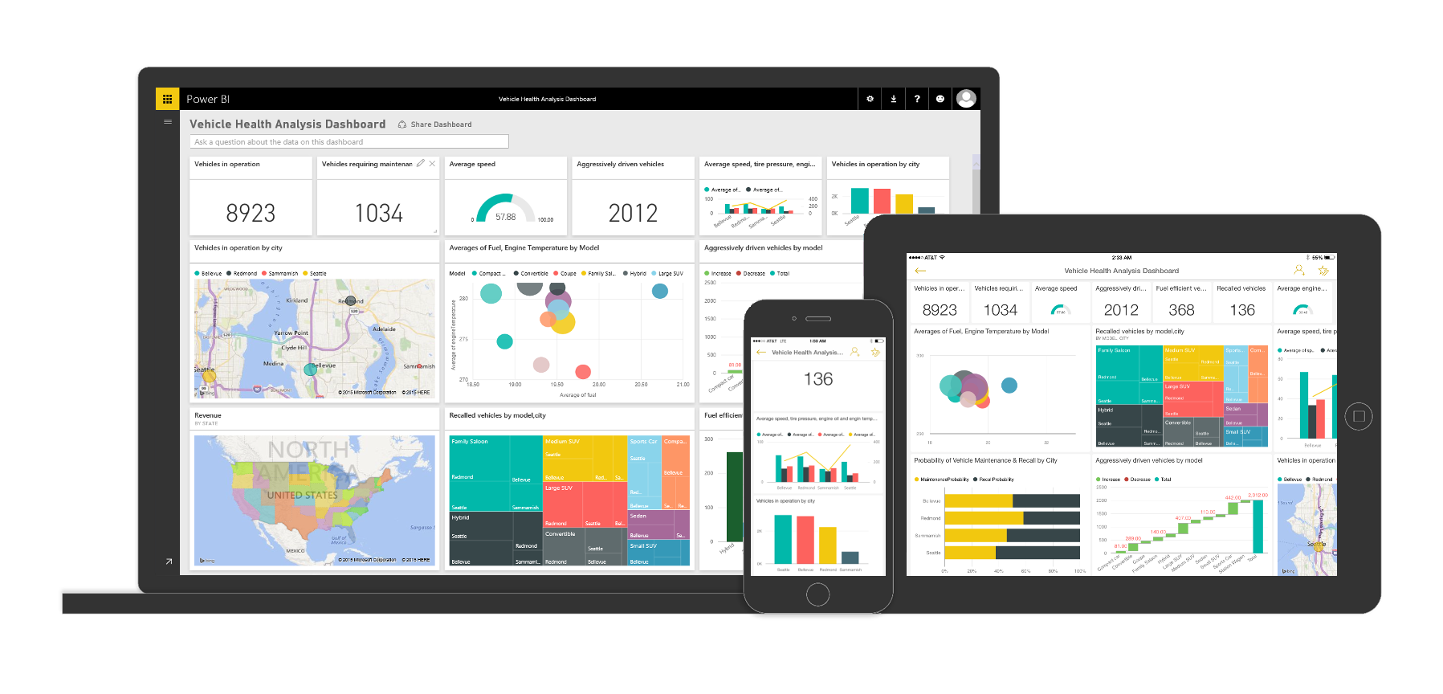
Support business strategy with any data
Back-end power
Front-end insights
Big data
Web data
Traditional data
OLTP
ERP
CRM
LOB

Slide 13
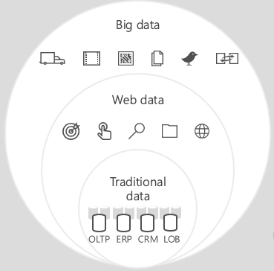
Predict and respond proactively
Azure Machine Learning templates
Azure Machine Learning service
Demand forecasting
Predictive maintenance
Vehicle telemetry
Data
Modeling & APIs
Clients
ML STUDIO
API

Slide 14
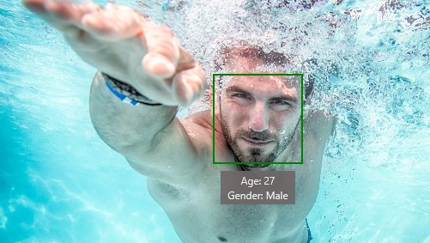
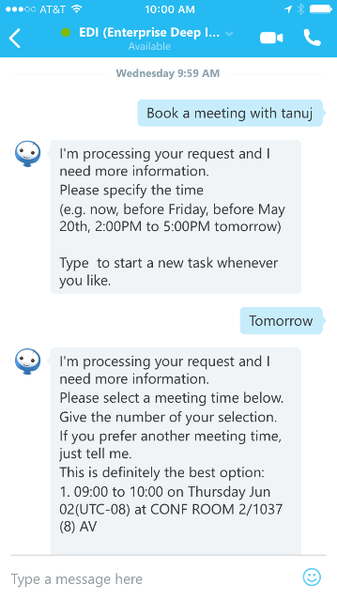
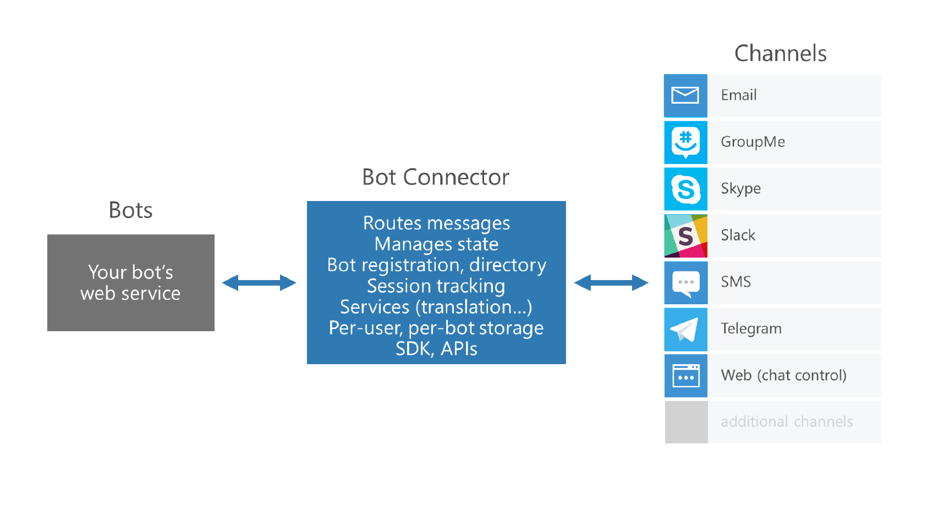



Learn and engage with artificial intelligence
Cognitive services
Bot framework
Is Adult Content: False
Categories: people_swimming

Slide 15


Data and intelligence

Slide 16
Application innovation
Accelerate innovation with the cloud
Data and intelligence
Power decisions & apps with insights
Microsoft Azure
Openness and flexibility
Build freely, deploy anywhere
Trust
Protect your business

Slide 17
Openness and flexibility Build freely, deploy anywhere
Build and run open source solutions
Extend on-premises data and apps
Deploy the cloud on-premises

Slide 18





























Build and run open source solutions
Any tool, application, framework
Applications
DevOps
Frameworks
Databases & middleware
Containers
Infrastructure

Slide 19
Extend on-premises data and apps
Hybrid Use Cases
Seamless & secure across:
Application Availability
Bottomless Storage
Identity Management
Full hybrid applications
INFRASTRUCTURE
Azure Backup
Azure Site Recovery
DATA
Azure StorSimple
SQL Server Stretch DB
USERS
Azure Active Directory
APPS
App Service
Web | Mobile | Logic Apps | API Apps
MANAGEMENT
Operations Management Suite

Slide 20
Deploy the cloud on-premises
Azure Stack
Portal | PowerShell | Dev-ops tools
Portal | PowerShell | Dev-ops tools
One Azure ecosystem
Azure Resource Manager
Azure Resource Manager
Unified app development
Azure IaaS | Azure PaaS
Azure IaaS | Azure PaaS
Compute | Networking | Storage
App Service | Service Fabric
Azure services in your datacenter
Cloud infrastructure
Cloud-inspired infrastructure
Microsoft Azure
PUBLIC
Microsoft Azure Stack
PRIVATE | HOSTED

Slide 21

Openness and flexibility

Slide 22
Application innovation
Accelerate innovation with the cloud
Data and intelligence
Power decisions & apps with insights
Microsoft Azure
Openness and flexibility
Build freely, deploy anywhere
Trust
Protect your business

Slide 23
Trust Protect your business
Detect and mitigate threats
Achieve global scale, in local regions
Benefit from relentless business commitment

Slide 24
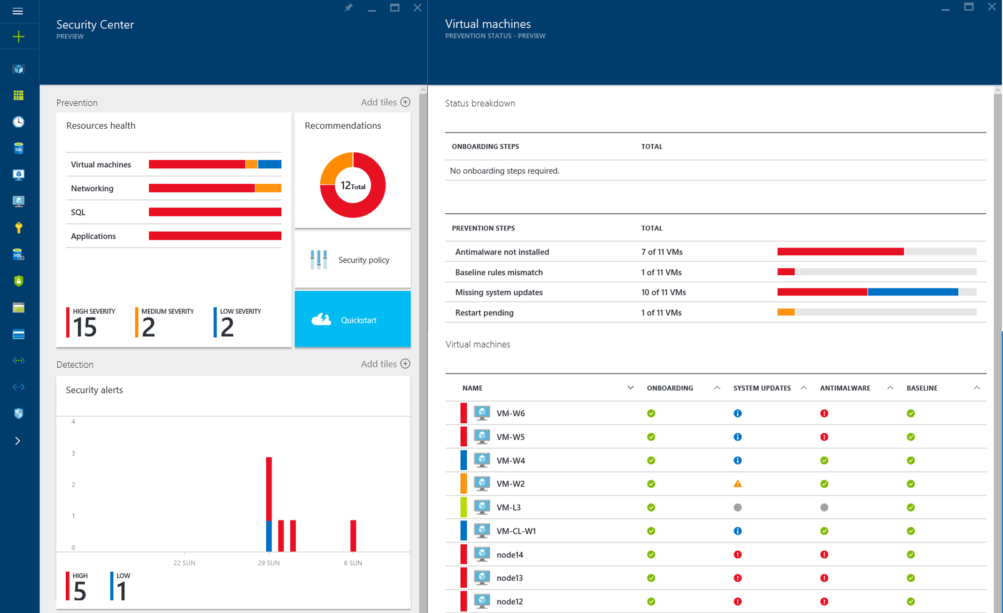
Detect and mitigate threats
Securing the platform
Empowering you
RED TEAM
BLUE TEAM

Slide 25
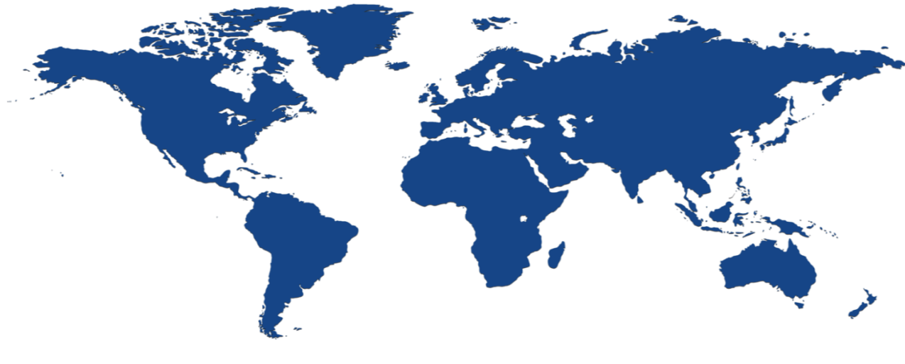


Achieve global scale, in local regions
34
regions

Slide 26
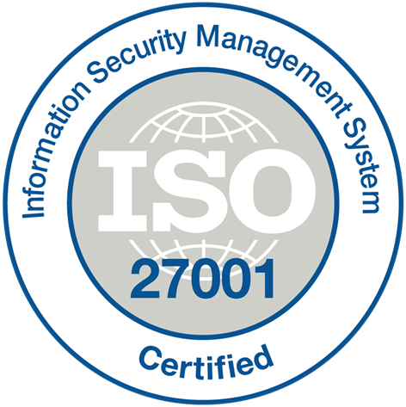



























Benefit from relentless business commitment
ISO 27001
SOC 1 Type 2
SOC 2 Type 2
PCI DSS Level 1
Cloud Controls Matrix
ISO 27018
Content Delivery and Security Association
Shared
Assessments
FedRAMP
JAB P-ATO
HIPAA/ HITECH
FIPS 140-2
21 CFR
Part 11
FERPA
DISA Level 2
CJIS
IRS 1075
ITAR-ready
Section 508 VPAT
European Union Model Clauses
EU Safe Harbor
United Kingdom
G-Cloud
China Multi
Layer Protection
Scheme
China
GB 18030
China
CCCPPF
Singapore
MTCS Level 3
Australia
Signals
Directorate
New
Zealand GCIO
Japan
Financial Services
ENISA
IAF

Slide 27
Application innovation
Accelerate innovation with the cloud
Data and intelligence
Power decisions & apps with insights
Microsoft Azure
Openness and flexibility
Build freely, deploy anywhere
Trust
Protect your business

Slide 28
Microsoft Cloud
Secure Productive Enterprise &
Operations Management + Security
Cortana Intelligence Suite
Office 365
Dynamics
Azure
PRODUCTIVITY
BUSINESS APPS
SECURITY & MANAGEMENT
DATA & INTELLIGENCE
APPLICATION INNOVATION

Slide 29
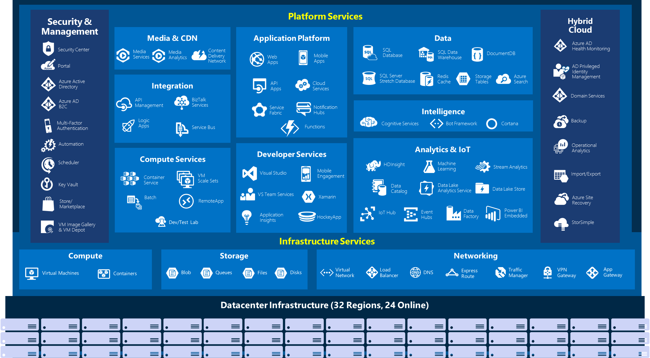

Slide 30
Azure Portal Demo

Slide 31
Questions?

Slide 32
Thank You!

